Slide 1

IBM 25 - Jahr - Klub
Veranstaltung Hannover
Dr.-Ing. Uwe Winkelhake
Hannover, 05.11.2016

Slide 2
IBM is becoming a Cognitive Solutions & Cloud Platform company

Slide 3
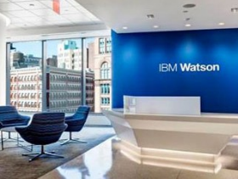

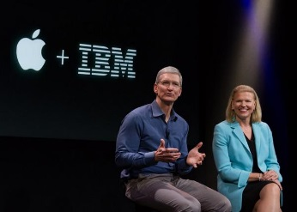
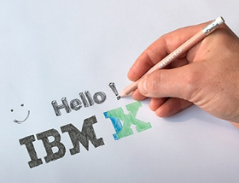

With organic growth, partnerships and acquisitions IBM has become the largest Digital Agency worldwide
Watson IoT
Aperto
Apple Partnership
500+ Enterprise Apps
1000+ Developers
iX Design Studios
ecx.io
2014
2015
2016

Slide 4


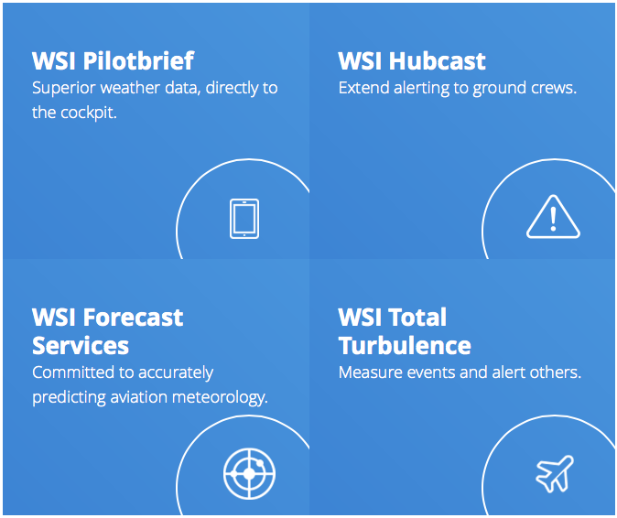
IBM acquired The Weather Company which brings a fantastic set of data and services to build Cognitive IoT Solutions
Example: Industry Solution Aerospace
163M unduplicated platform consumers
  8 Billion API requests daily
  #1 Rated in forecast accuracy
  40 million mobile phones

Slide 5
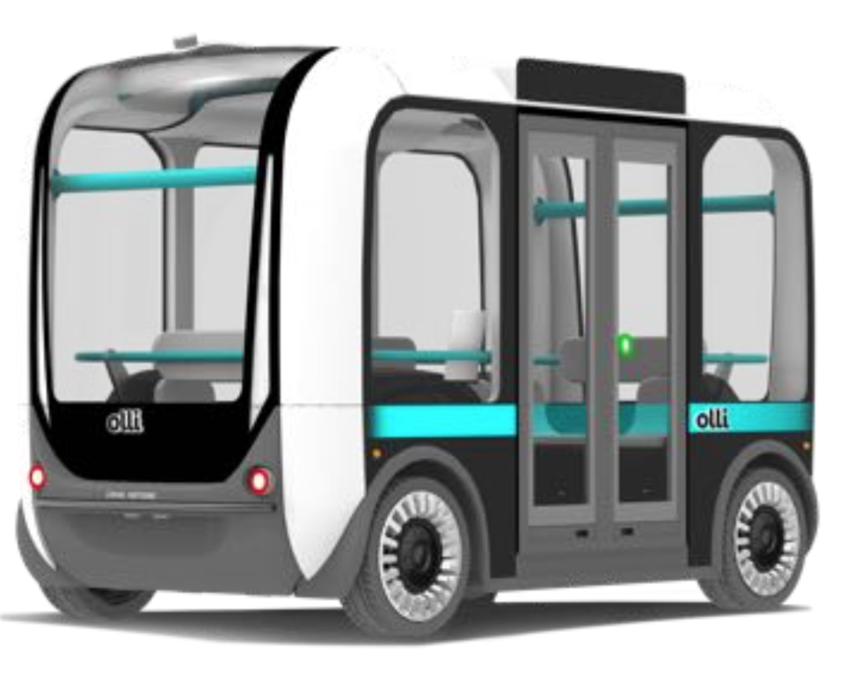
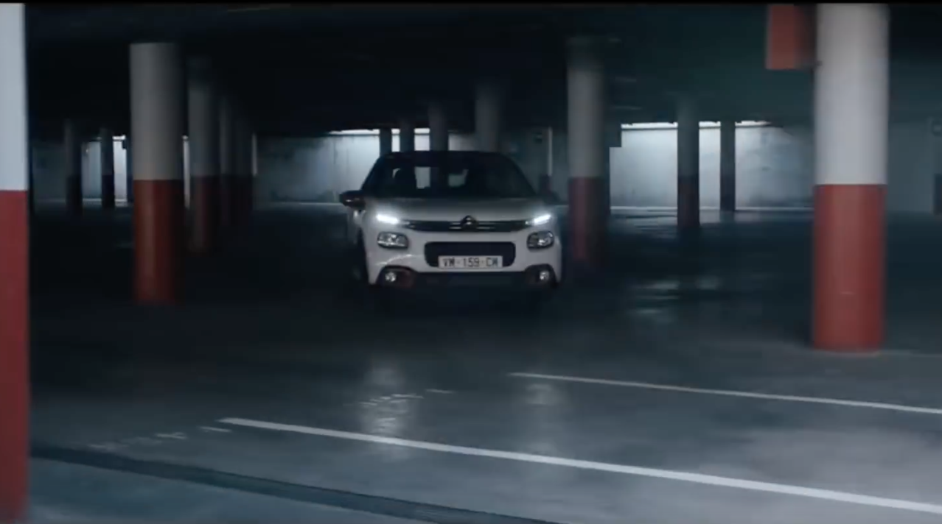
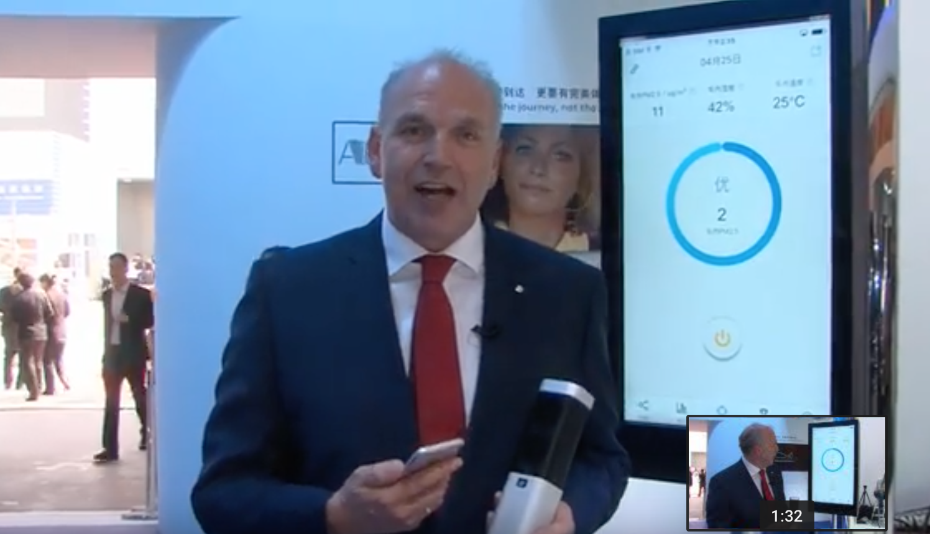
Cognitive references ...
Local Motors’ Olli
The cognitive self-driving vehicle
PSA
Connected Mobility Development Platform for Developers
VW
Intelligent Air Quality Sensor
Link:
https://www.youtube.com/watch?v=K564rXrlZbc
Link: https://www.youtube.com/watch?v=FumoLLdsEq4
Link: http://www.youtube.com/watch?v=kZcKC-pIADc&t=1m19s

Slide 6
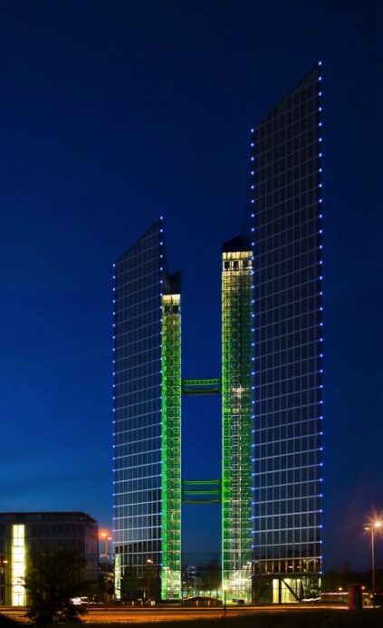
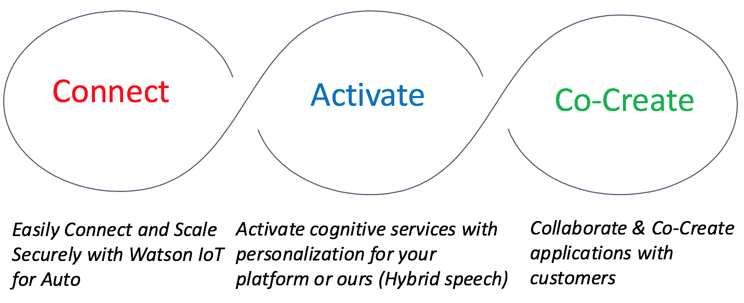
The new Watson IoT Innovation Center in Munich provides a space for co-creation and innovation in the Auto industry
On December 15, 2015, IBM announced the Global Watson IoT Headquarter in Munich, Germany
IBM‘s biggest investment in Europe for over 20 years
More than 1000 developers, consultants researchers and designers will work together with clients and partners to develop a new generation of cognitive capabilities and IoT implementation.
Part of the Watson IoT Center is a dedicated team of the AutoLAB

Slide 7
Digitization is a journey …
Needed to differentiate and lead
Cognitive Enterprise
Customer
experience
Transform Business Models
Digital Enterprise
Enhance and scale Knowledge
Incremental Optimization
Business Ecosystem
Established Processes
Digital Transformation
Foundational
digital capabilities
Streamline &
Improve processes
Optimise IT
Competitive advantage
Efficiency
Accuracy
Reach
Connectivity
Knowledge
Relationship

